Slide 1
Foundation Models and Large Language Models
Generative AI
Module 1 – Lesson 2
Notes:
Foundation models and large language models are at the core of generative AI. These powerful models serve as the foundation for numerous advanced applications, enabling us to tackle challenging tasks more effectively. Foundation models and large language models are versatile and can be adapted to various domains. This presentation delves into the concepts and capabilities of these models, which are driving innovation in the field of generative AI.

Slide 2
Today’s activities
Traditional ML
Foundation models and LLMs
Transformers Architecture
Challenges and Limitations of LLMs
Notes:
Popular machine learning approaches involve training models on specific tasks using labeled data. Foundation models and large language models are powerful neural networks trained on vast amounts of unlabeled data, allowing them to acquire broad knowledge and capabilities. The Transformers architecture, with its self-attention mechanism, is a key innovation enabling the success of large language models. However, these models face challenges like lack of grounding, biases, and the need for efficient inference. This lesson explores the evolution from traditional ML to foundation models, their underlying architecture, and the current limitations being addressed.

Slide 3
Review: Traditional ML (1/2)
Trained on task-specific data
Models specialized for the task
Training typically starts from scratch
Several model choices
Tree-based models, linear models, neural networks, etc.
Notes:
Traditional machine learning models are trained on data specific to the task they are designed to solve. The models are tailored and optimized for that particular task, making them highly specialized. The training process starts from scratch, without leveraging any prior knowledge or pre-trained representations. There are various model architectures available, such as tree-based models, linear models, neural networks, and others. Each model type has its own strengths and weaknesses, and the choice depends on the characteristics of the problem and the data.

Slide 4
Review: Traditional ML (2/2)
Optimized for one task
Classification, regression, clustering
Challenging to adapt to another similar task
Notes:
Traditional machine learning models are highly specialized and optimized for specific tasks like classification, regression, or clustering. However, adapting these models to similar tasks can be challenging. Since they are trained from scratch on task-specific data without leveraging any prior knowledge or pre-trained representations, extensive feature engineering and domain expertise are required to extract relevant features from raw data. This process is time-consuming and labor-intensive. Consequently, traditional ML models lack scalability and generalization capabilities, as each new task necessitates starting from scratch and repeating the feature engineering process, hindering their applicability to new domains or tasks.

Slide 5
Review: Machine learning terminology
ML: Train a computer to recognize patterns in historical data to make predictions on new data
features
label
The ML algorithm takes a random function and refines it until the features predict the correct label.
Number of logins | Watched Prime Video | … | Number of purchases
120 | Yes | … | 4
1 | No | … | 0
219 | No | … | 12
57 | Yes | … | 2
0 | No | … | 0
23 | Yes | … | 1
Prime signup after free trial
Yes
No
Yes
Yes
No
No
f
model
Notes:
Machine learning involves training a computer model to recognize patterns in historical data, enabling it to make predictions on new, unseen data. The core idea is that an ML algorithm starts with a randomly initialized function and iteratively refines it until the features accurately predict the desired label. The example illustrates this concept by aiming to predict whether a user will sign up for a paid Prime subscription after their free trial. The relevant features considered include the number of logins, whether the user watched a Prime video, the number of purchases made, and so on. The ML algorithm learns to map these features to the label, which indicates if the user will convert to a paid subscription or not. The model essentially captures the learned relationship between the input features and the output label. Once trained on historical data, it can then make predictions for new users based on their feature values, forecasting their likelihood of subscribing to Prime after the free trial period. This exemplifies how machine learning can uncover patterns from data to make accurate predictions, with applications across various domains.

Slide 6
Review: Foundation models
Large ML models that are pre-trained with vast amounts of data. These can be adapted to more specialized tasks.
Can be trained on any kind of data
Text
Images
Video
Audio
Etc…
Foundation models
Notes:
Let's quickly review what foundation models are from our previous lesson. Foundation models are large machine learning models pre-trained on vast amounts of data. The initial broad pre-training allows efficient transfer and specialization to specific applications.

Slide 7
Review: Large Language Models (LLMs)
Foundation models trained on text.
Large ML models that learn the probabilities of words being used in certain contexts.
Training task: Learn to predict the missing word in a text sequence.
Foundation models
Large Language Models (LLMs)
“The weather has been cloudy for the last two days. Most likely it will be ____ tomorrow.”
cloudy?
sunny?
foggy?
….
Notes:
Large Language Models are foundation models trained on vast text data to learn word probabilities in different contexts. Their training involves predicting missing words in text sequences or predicting the next word given a phrase, allowing them to understand language patterns and generate contextually appropriate text for various applications.

Slide 8
Foundation models (FMs)
Tasks
Tasks
…
…
Text generation
Text generation
…
…
Summarization
Summarization
Unlabeled data
FM
Labeled data
ML models
Information extraction
Information extraction
…
…
Q&A
Q&A
…
…
Chatbot
Chatbot
Train
Deploy
Pretrain
Adapt
Traditional ML models
Foundation models
Notes:
Unlike traditional models that are trained on labeled data for specific tasks, foundation models are pretrained on vast amounts of unlabeled data in a self-supervised manner. This pretraining allows the model to learn general language patterns and knowledge, which can then be adapted or fine-tuned for various downstream tasks like text generation, summarization, information extraction, question answering, and chatbots. The key advantage of foundation models is their ability to leverage the knowledge gained from pretraining on large datasets, enabling efficient adaptation to new tasks with relative ease. This approach contrasts with traditional ML models that require extensive labeled data for each individual task, making foundation models more versatile and efficient for a wide range of applications.

Slide 9
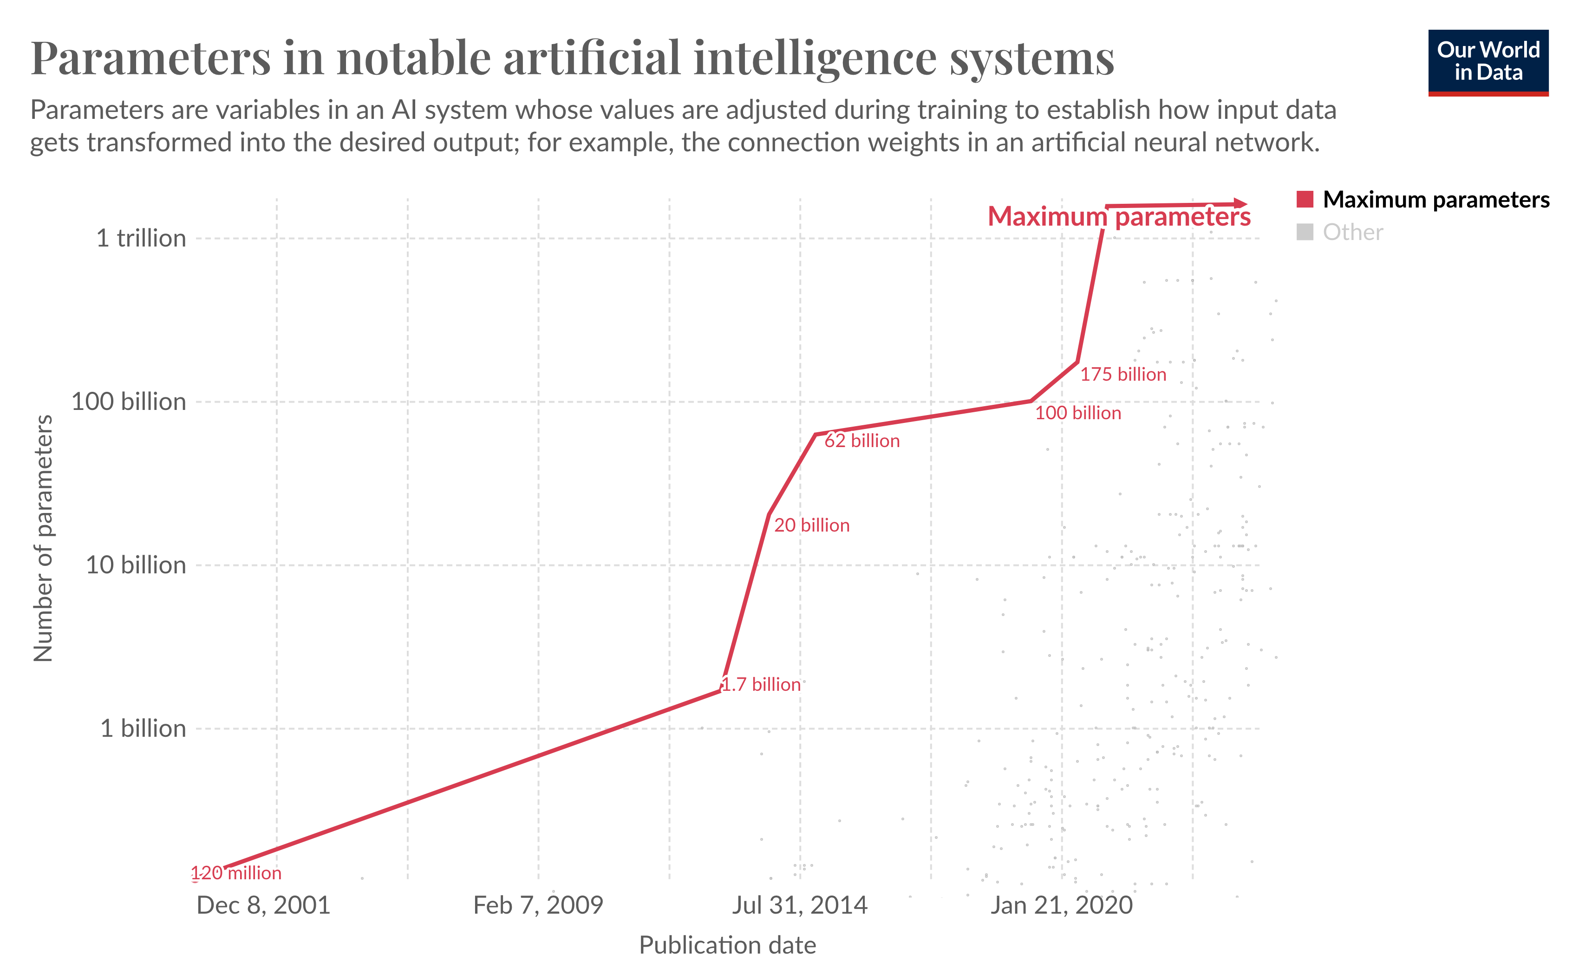
The growth of LLMs
Source: outworldindata
Notes:
The growth of large language models has been remarkable, as illustrated by the graph showing the increasing number of parameters in notable artificial intelligence systems over time. Parameters or weights are variables in a model whose values are adjusted during training to establish how input data gets transformed into the desired output, such as the connection weights in an artificial neural network. The graph traces the evolution of maximum parameter counts, starting from a modest 120 million parameters in December 2001 for early models. Over the years, the parameter counts have grown exponentially, reaching 1.7 billion by July 2014, 175 billion by January 2020, and a staggering trillion parameters by the most recent data point. This rapid growth in parameter counts reflects the increasing complexity and capability of LLMs, enabling them to capture and model intricate language patterns and semantics more effectively. However, it's important to note that parameter count alone is not the sole determinant of an LLM's performance; factors such as model architecture, training data quality, and optimization techniques also play crucial roles.
Source: https://ourworldindata.org/grapher/artificial-intelligence-parameter-count?zoomToSelection=true&time=1998-11-01..latest&showSelectionOnlyInTable=1

Slide 10
Transformer Networks
Notes:
Transformer networks have emerged as a pivotal architecture in the field of generative AI applications. Let's examine their architecture and some key concepts that led to their rise in popularity.

Slide 11
Sequence-to-sequence models
Use input sequences to produce output sequences.
Input and output are both variable-length sequences.
Examples:
Auto-completion
Machine translation
What is AWS
English
Spanish
What is AWS WAF
What is AWS STS
What is AWS Guardduty
What is AWS Security Hub
What is AWS Lambda
Hello
Hola
Notes:
Sequence-to-sequence models are a class of machine learning models designed to handle input and output sequences of variable lengths. These models take an input sequence, such as a sentence or a series of words, and produce an output sequence as the response. One of the key advantages of sequence-to-sequence models is their ability to handle variable-length inputs and outputs. This makes them well-suited for tasks like machine translation, where the input and output sentences can have different lengths, or text summarization, where the output summary can be shorter or longer than the input text. In the auto-completion example, the model takes a partial input sequence, such as "why is Texas", and generates possible completions like "why is texas so big" or "why is texas called the lone star state." In the machine translation example, the model takes an input sequence in one language and generates the corresponding output sequence in another language.

Slide 12
Encoder-Decoder Architecture
“Ils regardent”
Example: Machine translation
(English -> French)
0.12
1.23
-0.16
…
…
…
Encoder
Decoder
Input
Output
“They are watching”
Context Vector
Notes:
The encoder-decoder architecture is commonly used for sequence-to-sequence tasks, where the input and output can have variable lengths. It consists of two main components: the encoder and the decoder. The encoder processes the input sequence and converts it into a numerical representation called the context vector. This context vector captures the meaning of the input sequence in a compact form. The decoder then takes this context vector and generates the output sequence, one element at a time, based on the information encoded in the context vector. This architecture is particularly useful for tasks like machine translation, where the input sentence in one language needs to be translated into an output sentence in another language. The encoder can process the input sentence and encode its meaning into the context vector, while the decoder can then use this context vector to generate the translated sentence in the target language.

Slide 13
Transformers
Developed as an encoder-decoder model
Uses the attention mechanism
Rich semantic and syntactic representation
Long context memory
Parallel processing of inputs
Distributed inference
“George Washington”
Decoder
Encoder
Positional Encoding
+
+
Positional Encoding
“Who was the first president of the United States?”
Embedding
Embedding
Notes:
Transformers are a type of encoder-decoder model that employs the attention mechanism, allowing the model to focus on relevant parts of the input sequence when generating the output. This architecture offers several advantages, including rich semantic and syntactic representation, long context memory, parallel processing of inputs, and distributed inference. The attention mechanism enables the model to capture long-range dependencies and model complex relationships within sequences, leading to improved performance in various natural language processing tasks.

Slide 14
Transformers
Encoder generates rich representation of input
Decoder generates relevant content
Output is again passed as input to the decoder
Positional information added to input
“George Washington”
Decoder
Encoder
Positional Encoding
+
+
Positional Encoding
“Who was the first president of the United States?”
Embedding
Embedding
Notes:
The encoder generates a rich representation of the input by capturing its semantic and syntactic information. In this example, the input is "Who was the first president of the United States", which the encoder processes to create a dense vector representation. The decoder then generates relevant content based on this encoded representation and generates the answer, 'George Washington'. It does so by attending to the appropriate parts of the encoded input and generating the output token by token. An important aspect is that the output generated by the decoder is fed back into itself as input for the next step. This allows the model to consider the previously generated tokens when producing the next token, enabling it to maintain coherence and context in the output sequence. Additionally, positional encoding is applied to the input sequences, providing the model with information about the order and position of tokens. This is crucial for understanding and generating sequences correctly. We will discuss the role of the embedding module in the subsequent sections.

Slide 15

Attention Mechanism
Attention helps models associate each word with other words in the sentence
High attention
Mid attention
Low attention
Notes:
The attention mechanism helps models associate each word in a sentence with other relevant words, capturing the relationships and dependencies between them. This is illustrated with the example sentence "the rabbit couldn't cross the street because it was too tired". The attention weights, depicted by the shaded squares, show the degree of association between the word "it" and every other word in the sentence. Words that are highly relevant to "it", like "rabbit" and "tired", have higher attention weights, while less relevant words like "the" and "cross" have lower weights. This allows the model to effectively focus on the most important parts of the sentence when processing the word "it", leading to better understanding and generation of coherent text.

Slide 16
Attention Mechanism
Allows the model to access all the words/tokens in the observable input
Indicates which tokens are most relevant for the next prediction
Both the encoder and decoder use the attention mechanism
Multi-headed attention module
Notes:
The attention mechanism serves two key purposes in language models. Firstly, it allows the model to access and consider all the words or tokens in the input sequence, ensuring that no information is overlooked. Secondly, it helps identify which tokens are most relevant for making the next prediction, enabling the model to focus its attention on the most important parts of the input. Both the encoder and decoder components of the model leverage the attention mechanism. Specifically, they employ a multi-headed attention module, which consists of multiple attention heads that generate rich representations simultaneously. By selectively attending to the most relevant parts of the input sequence, the attention mechanism enables the model to effectively process long sequences and handle long-range dependencies.

Slide 17
Encoder-only Architecture
Only uses the encoder block
Attention layers access all the words in the input sentence.
Bi-directional attention
Suitable for Natural Language Understanding (NLU) tasks
Sentence classification
Named entity recognition (NER)
Text extraction
Examples:
BERT Models
ELECTRA
[0.12, 1.23, -0.16, …, … ]
Encoder
Positional Encoding
+
Embedding
That movie was awesome!
Notes:
The encoder-only architecture is a variation of transformer network that utilizes only the encoder block. In this architecture, the attention layers within the encoder have access to all the words or tokens in the input sentence, enabling bi-directional attention. This means that when processing a particular word, the model can attend to both the words before and after it, allowing for a more comprehensive understanding of the context. The encoder-only architecture is well-suited for Natural Language Understanding tasks, such as sentence classification, named entity recognition, and text extraction. These tasks typically involve understanding and analyzing the input text without generating any output text. Some examples of models that employ the encoder-only architecture are BERT and ELECTRA. These models have achieved state-of-the-art performance at the time of release on various NLU benchmarks and have been widely adopted in the field of natural language processing.

Slide 18
Decoder-only Architecture
Only uses the decoder block
Only access words that came before
Auto-regressive models
Generate next token based on input
Suitable for text generation tasks
Examples:
GPT Models by OpenAI
Llama models by Meta
Claude models by Anthropic
vacation
Decoder
+
Positional Encoding
Embedding
How was your
Notes:
The decoder-only architecture is another type of transformer model that solely utilizes the decoder block. In this architecture, the attention layers within the decoder can only access words or tokens that came before the current position, enabling auto-regressive modeling. This means that the model generates the next token based on the input and the previously generated tokens, making it suitable for text generation tasks such as machine translation, summarization, and content generation. Auto-regressive models are a key characteristic of the decoder-only architecture, where the output is generated one token at a time, with each token being conditioned on the previously generated tokens. A few examples of models that employ the decoder-only architecture include the GPT models by OpenAI, Llama models by Meta, and Claude models by Anthropic, among others. These models have demonstrated impressive performance in various text generation tasks, leveraging the power of the decoder-only architecture to generate coherent and contextually relevant text.

Slide 19
Transformers: Summary
State-of-the art deep learning architecture
Propelled the growth and adoption of Generative AI
Transformers can process the input data in parallel
Self-attention mechanism capture interdependencies between all words, regardless of position
Typically undergo self-supervised learning
Labels generated automatically from unlabeled data
No need to curate labelled data
Increasingly popular with Computer Vision (CV), Audio, Reinforcement Learning (RL) tasks, and multi-modal applications
Notes:
Let's do an overview of transformers networks. Transformers are a cutting-edge deep learning architecture that has revolutionized the field of Generative AI. They possess the remarkable ability to process input data in parallel. This architecture employs a self-attention mechanism that captures interdependencies between all words or tokens, irrespective of their position in the sequence. One of the key advantages of transformers is their capability to undergo self-supervised learning. In this approach, labels are automatically generated from unlabeled data, eliminating the need for manually curated labeled datasets. This self-supervised learning paradigm has significantly expanded the applicability of transformers across various domains. Transformers have gained widespread adoption in diverse fields, including Computer Vision, Audio Processing, Reinforcement Learning tasks, and multi-modal applications. Their versatility in handling diverse data types, combined with their self-supervised learning capabilities, has made them a powerful tool for a wide range of applications, driving innovation and advancing the frontiers of artificial intelligence.

Slide 20
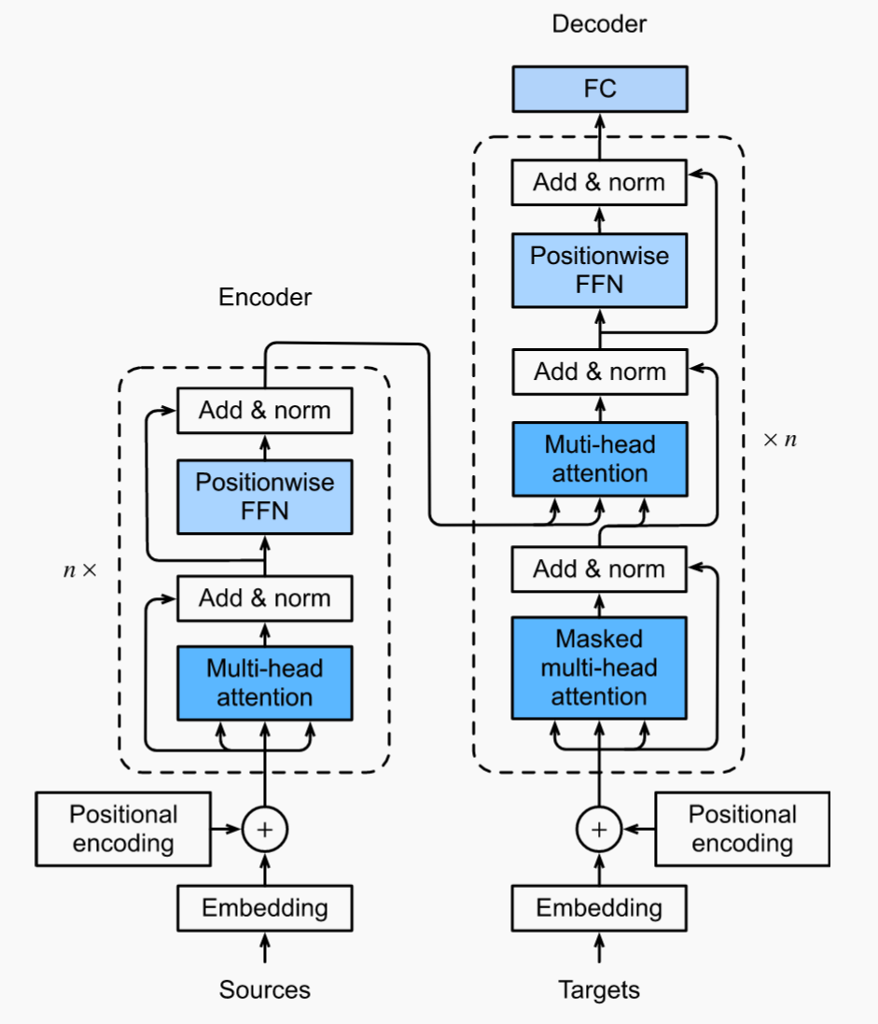
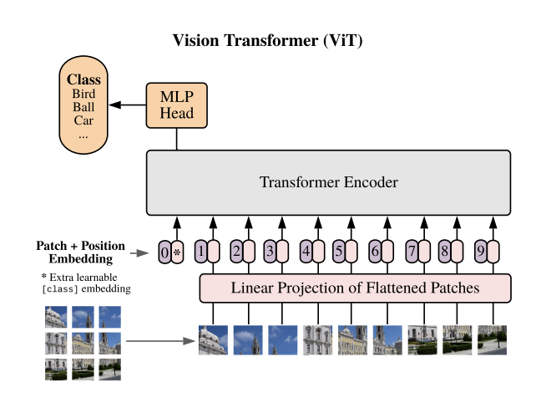
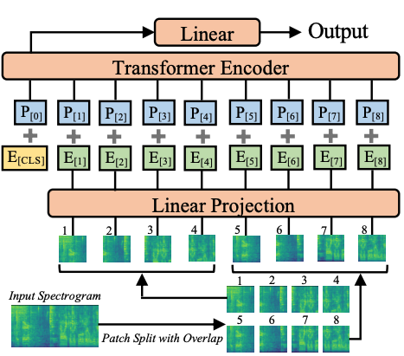
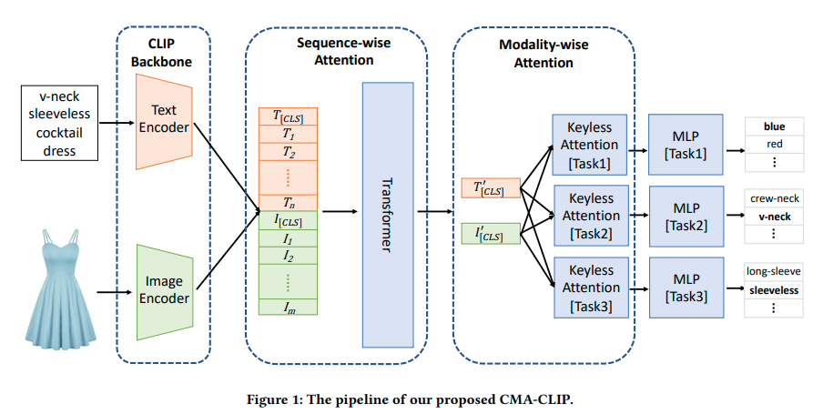
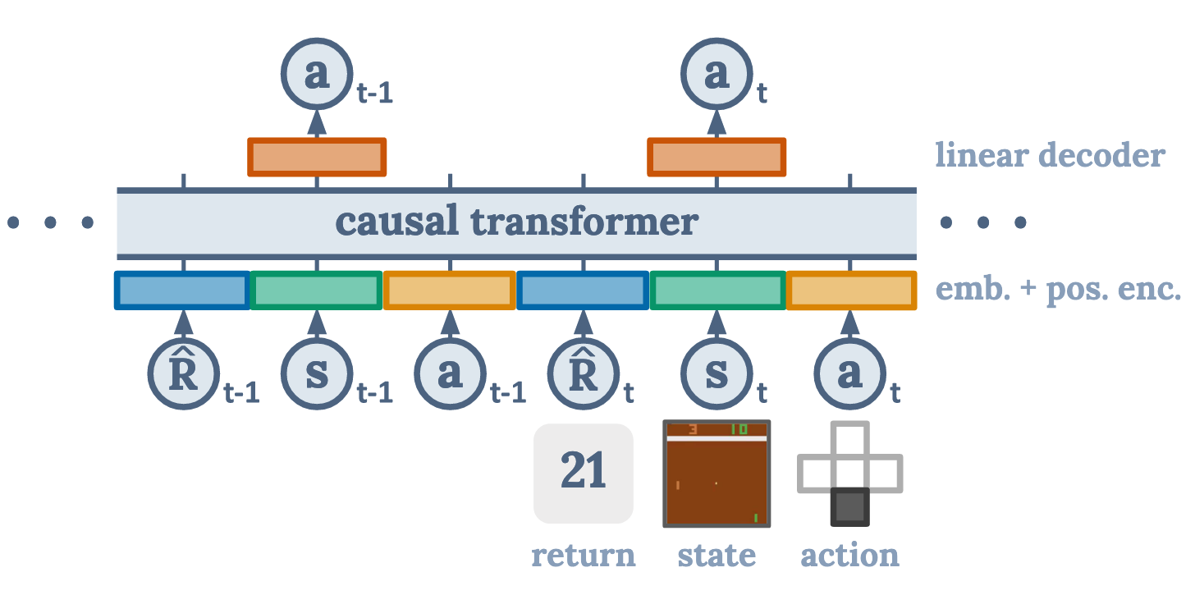
Transformers for all!
Audio
NLP
Computer Vision (CV)
Multimodal
Reinforcement Learning (RL)
Notes:
The image illustrates the versatility of transformer models across different domains and modalities. It showcases their applications in Natural Language Processing, Computer Vision, Audio processing, Reinforcement Learning, and Multimodal tasks. The image highlights the transformer's ability to handle diverse data types and tasks, making it a powerful architecture in the field of deep learning. NLP: https://arxiv.org/abs/1706.03762 ViT Image: https://arxiv.org/abs/2010.11929v2
Audio Spectogram Transformer: https://arxiv.org/abs/2104.01778
RL: Decision transformer https://arxiv.org/abs/2106.01345
Multi-modal: CMA-CLIP: Cross-Modality Attention CLIP for Image-Text Classification https://arxiv.org/pdf/2112.03562v2.pdf

Slide 21
Challenges and Limitations of LLMs
Notes:
Large language models have proven to be remarkably capable, but they also face several limitations and challenges. In this section, we will discuss some limitations of LLMs.

Slide 22
Challenges and limitations of LLMs (1/3)
Reliability and bias
Knowledge limited to the training data
Inability to discern false information or bias
Context window
Model’s attention limited to the context window
Inputs exceeding the context window length are invisible to the model
For instance, Titan Premier had a limit of 30,000 tokens at the time of release
Notes:
Large language models face reliability and bias issues primarily stemming from their training data. Since LLMs can only learn from the data they are trained on, any biases or inaccuracies present in that data get encoded into the model's knowledge. This means LLMs lack the ability to critically evaluate the information they have learned or correct any false information or biases. Their outputs simply reflect the data they were exposed to during training, which may be problematic if that data is flawed or skewed. Another major limitation is the context window size. These models have a finite context length that they can attend to at once. Any input that exceeds this context window becomes invisible to the model. This can lead to inconsistencies, lack of coherence, or missed context when generating text spanning long contexts beyond the model's window size. The example given highlights how even large models like Titan Premier have a limited context window of 30,000 tokens at launch, limiting their ability to maintain coherence over longer inputs or documents.

Slide 23
Challenges and limitations of LLMs (2/3)
Potential copyright infringement issue
Training data might contain sensitive or copywrite data
May generate content similar to someone’s intellectual or creative property
Have ethical and legal implications
Create and propagate misinformation
May generate personal or sensitive data that could be used to identify and harm others
Create and propagate misinformation about individuals, groups, organizations, etc
Notes:
Large language models face potential copyright infringement issues due to the nature of their training data and generated content. The training data might contain sensitive or copyrighted material, which raises legal concerns. Additionally, the generated content could be similar to someone's intellectual or creative property, leading to ethical and legal implications. Another significant challenge is the ability of LLMs to create and propagate misinformation. These models may generate personal or sensitive data that could be used to identify and harm individuals. Furthermore, they can create and spread misinformation about individuals, groups, organizations, and other entities, which is a major concern given the widespread reach and influence of these models.

Slide 24
Challenges and limitations of LLMs (3/3)
System costs
Requires significant investment in the form of computer systems, human capital (engineers, researchers, scientists, etc.), and power.
Models with >100 billion parameters can have a total project cost of over $100 million
Environmental Impact
LLMs need a lot of power and leave behind large carbon footprints
According to a study, CO₂ emissions from training 5B models on GPU is roughly equivalent to a trans-American flight.
Notes:
Large language models are computationally intensive and require significant resources, both in terms of infrastructure and human capital. Developing and training these models necessitates substantial investments in powerful computer systems, specialized personnel like engineers, researchers, and scientists, as well as substantial energy consumption. For models with over 100 billion parameters, the total project cost can exceed $100 million, highlighting the financial commitment required. Furthermore, the training process for LLMs has a considerable environmental impact due to their high energy demands. These models consume vast amounts of power, resulting in large carbon footprints. A study has shown that the CO2 emissions generated from training 5 billion parameter models on GPUs are roughly equivalent to the emissions from a trans-American flight. This environmental toll is a significant concern that needs to be addressed, as the development and deployment of LLMs continue to grow.

Slide 25

Next lesson
This lesson covered foundation modes and LLMs.
In the next lesson, you will learn about prompt engineering and a few techniques to improve the quality of the model’s response through prompting.
Notes:
This lesson covered foundation models and large language models. In the next lesson, you will learn about prompt engineering and a few techniques to improve the quality of the model's response through prompting.

Slide 26
Notes:
Thank you for your participation in this course! We appreciate your engagement and hope you found the content valuable.

